Slide 1


Slide 2


Android Development

Slide 3

Course objectives
Android Development
By completing this course you will be able to:
  Code with Kotlin Syntax

Slide 4


Course plan
Android Development
  History
  Functions
  Variables
  Class
  Dynamic

Slide 5
HISTORY
Android Development

Slide 6

Kotlin
History
  2016: First version of Kotlin
  2017: First interactions with Android
  2018: Kotlin 1.3 async programming
  2024: Kotlin 2.0
Notes:
[Title of the course]
Nov 8, 2008
Copyright © 2004-2005 NameOfTheOrganization. All rights reserved.
6

Slide 7
Kotlin
Characteristic
  Concise
  JVM too
  Lamda
  Java compatible
Notes:
[Title of the course]
Nov 8, 2008
Copyright © 2004-2005 NameOfTheOrganization. All rights reserved.
7

Slide 8
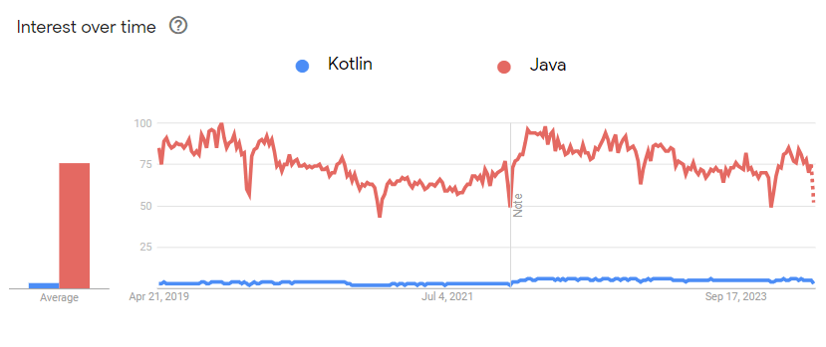
Kotlin
Kotlin vs Java
Notes:
[Title of the course]
Nov 8, 2008
Copyright © 2004-2005 NameOfTheOrganization. All rights reserved.
8

Slide 9
Kotlin
Syntax Kotlin
  At the beginning …
Package com.hesias
Import Kotlin.txt.*
Notes:
[Title of the course]
Nov 8, 2008
Copyright © 2004-2005 NameOfTheOrganization. All rights reserved.
9

Slide 10
Kotlin
Syntax Java vs Kotlin
  Create a function
public class HelloWorld {
public class void main (String[] args) {
System.out.println(“Hello World”);
}
}
fun sum (a: Int, b: Int) : Int {
return a + b
}
Or
fun sum (a: Int, b: Int) = a + b
Notes:
[Title of the course]
Nov 8, 2008
Copyright © 2004-2005 NameOfTheOrganization. All rights reserved.
10

Slide 11
Kotlin
Syntax Java vs Kotlin
  Create a VOID function
fun printSum (a: Int, b: Int): Unit {
println("sum of $a and $b is ${a + b}")
}
Notes:
[Title of the course]
Nov 8, 2008
Copyright © 2004-2005 NameOfTheOrganization. All rights reserved.
11

Slide 12
Kotlin
Syntax Java vs Kotlin
  Entry point
public class HelloWorld {
public class void main (String[] args) {
System.out.println(“Hello World”);
}
}
fun main () {
System.out.println(“Hello World”)
}
Notes:
[Title of the course]
Nov 8, 2008
Copyright © 2004-2005 NameOfTheOrganization. All rights reserved.
12

Slide 13
Kotlin
Kotlin Variables
  To declare a variable
    Use val or var
    No null but you can use ?
    ; is optional
    Cast is not implicit
Var quoteTxt = findViewById<View>(R.id.quoteText) as TextView
Var quoteTxt2 = findViewById<TextView>(R.id.quoteText)
Notes:
[Title of the course]
Nov 8, 2008
Copyright © 2004-2005 NameOfTheOrganization. All rights reserved.
13

Slide 14
Kotlin
Kotlin Variables
  To declare a variable
    Var to reuse
    Val to define
var x = 5
x += 1
val y = 5
val z : Int //to initilize later without null
Z = 5
Notes:
[Title of the course]
Nov 8, 2008
Copyright © 2004-2005 NameOfTheOrganization. All rights reserved.
14

Slide 15
Kotlin
Comment
  Same as java
//to initilize later without null
/*
Bloc of comments
*/
Notes:
[Title of the course]
Nov 8, 2008
Copyright © 2004-2005 NameOfTheOrganization. All rights reserved.
15

Slide 16
Kotlin
Null or not null ?
  By default:
  But ..
var a: String = "HESIAS"
a = null //no compilation possible
var a: String? = "HESIAS"
a = null //compilation possible
Notes:
[Title of the course]
Nov 8, 2008
Copyright © 2004-2005 NameOfTheOrganization. All rights reserved.
16

Slide 17
Kotlin
Null safety
  By default:
  But
var a: String = "HESIAS"
val y = a.length //it’s safe
var a: String? = "HESIAS"
val y = a.length //compilation error
Notes:
[Title of the course]
Nov 8, 2008
Copyright © 2004-2005 NameOfTheOrganization. All rights reserved.
17

Slide 18
Kotlin
Null safety
  To call a not safety var:
var a: String? = "HESIAS"
val y = a?.length
person?.department?.head = managersPool.getManager()
Notes:
[Title of the course]
Nov 8, 2008
Copyright © 2004-2005 NameOfTheOrganization. All rights reserved.
18

Slide 19
Kotlin
Kotlin Class
Open class Dog {
open fun sayHello() {
println("wow wow!")
}
}
class Yorkshire : Dog() { //extend Dog
override fun sayHello() {//surcharge
println("wif wif!")
}
}
//implementation
val dog: Dog = Yorkshire()
dog.sayHello()
Notes:
[Title of the course]
Nov 8, 2008
Copyright © 2004-2005 NameOfTheOrganization. All rights reserved.
19

Slide 20
Kotlin
Kotlin When
fun main() {
cases("Hello")
cases(1)
}
fun cases(obj: Any) {
when (obj) {
1 -> println("One")
"Hello" -> println("Greeting")
is Long -> println("Long")
!is String -> println("Not a string")
else -> println("Unknown")
}
}
Notes:
[Title of the course]
Nov 8, 2008
Copyright © 2004-2005 NameOfTheOrganization. All rights reserved.
20

Slide 21
Kotlin
Kotlin Loops
for(i in 0..3) {
print(i)
}
for(i in 0 until 3) {
print(i)
}
for(i in 2..8 step 2) {
print(i)
}
for (i in 3 downTo 0) {
print(i)
}
Notes:
[Title of the course]
Nov 8, 2008
Copyright © 2004-2005 NameOfTheOrganization. All rights reserved.
21
0123 012 2468 3210

Slide 22
Kotlin
Kotlin Dynamic
val a: dynamic = "abc"
val b: String = a
fun firstChar(s: String) = s[0]
println("${firstChar(a)} == ${firstChar(b)}")
println("${a.charCodeAt(0, "dummy argument")} == ${b[0].toInt()}")
println(a.charAt(1).repeat(3))
fun plus(v: dynamic) = v + 2
println("2 + 2 = ${plus(2)}")
println("'2' + 2 = ${plus("2")}")
Notes:
[Title of the course]
Nov 8, 2008
Copyright © 2004-2005 NameOfTheOrganization. All rights reserved.
22
a == a 97 == 97 bbb 2 + 2 = 4 '2' + 2 = 22

Slide 23
Questions ?

Slide 24

The end
Thanks for your attention

